Slide 1
Building Apps for the Office Store
Jim Epes, Office Store Product Marketing Manager
Scot Hillier, Office 365 MVP

Slide 2
Demo Fest of Some Leading Store Apps
Module 2

Slide 3

Agenda
App Types Supported in the Store
Architecture of Store Apps
Demo-fest:
Poll Everywhere
DocuSign
Nimble
Nintex

Slide 4
Developer vision
USERS
DATA
HTML

Slide 5
Overview: App Types Supported in the Store

Slide 6

Office 2013 development options
Pre-Office 2013 (not supported in Store)
Office 2013 desktop app (Store support)
Office 2013 web app (Store support)
Extending Office ribbon
Task pane app
Task pane app
COM add-in
Content app
Content app
Macro
Mail app
Mail app
VSTO

Slide 7
App shapes for Office 2013 (all Store supported)
Task pane
App adjacent to the document
Word, Excel, PPT, Project, Excel Online
Content
App in the body of the document
Excel & PPT, both rich client and online
Mail (both Read & Compose) Inline pane on an email or appointment item
Outlook and OWA

Slide 8
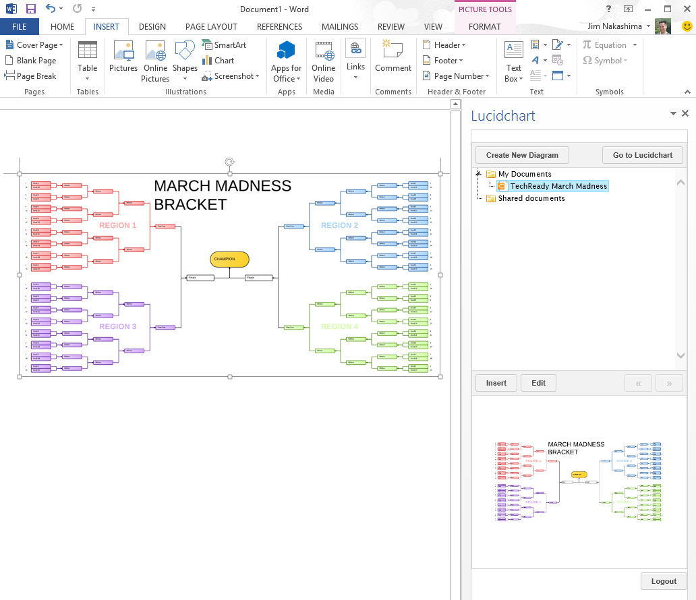
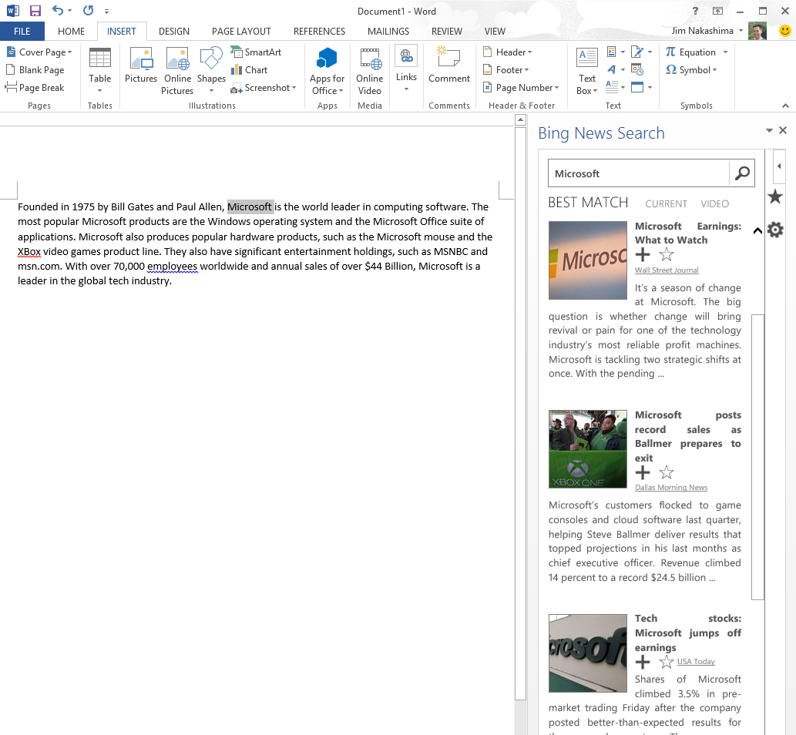
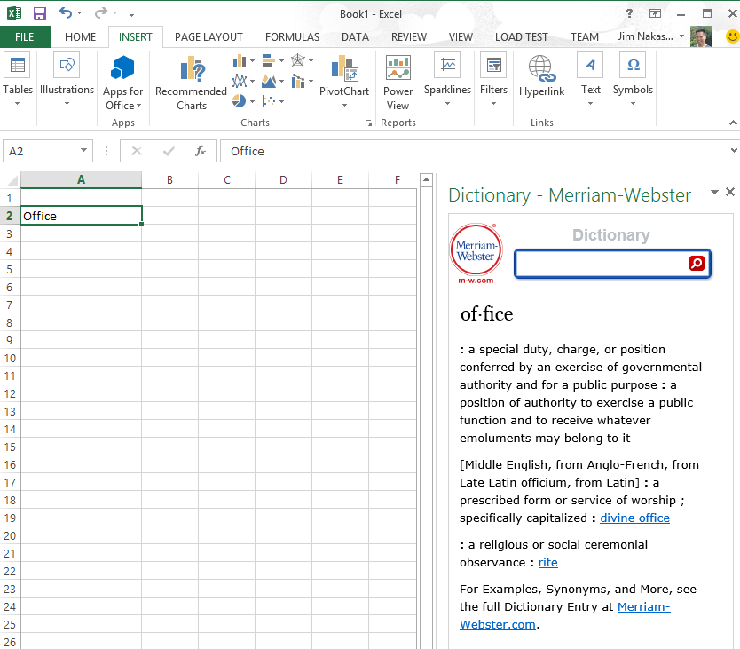
Sample Task Pane Apps

Slide 9
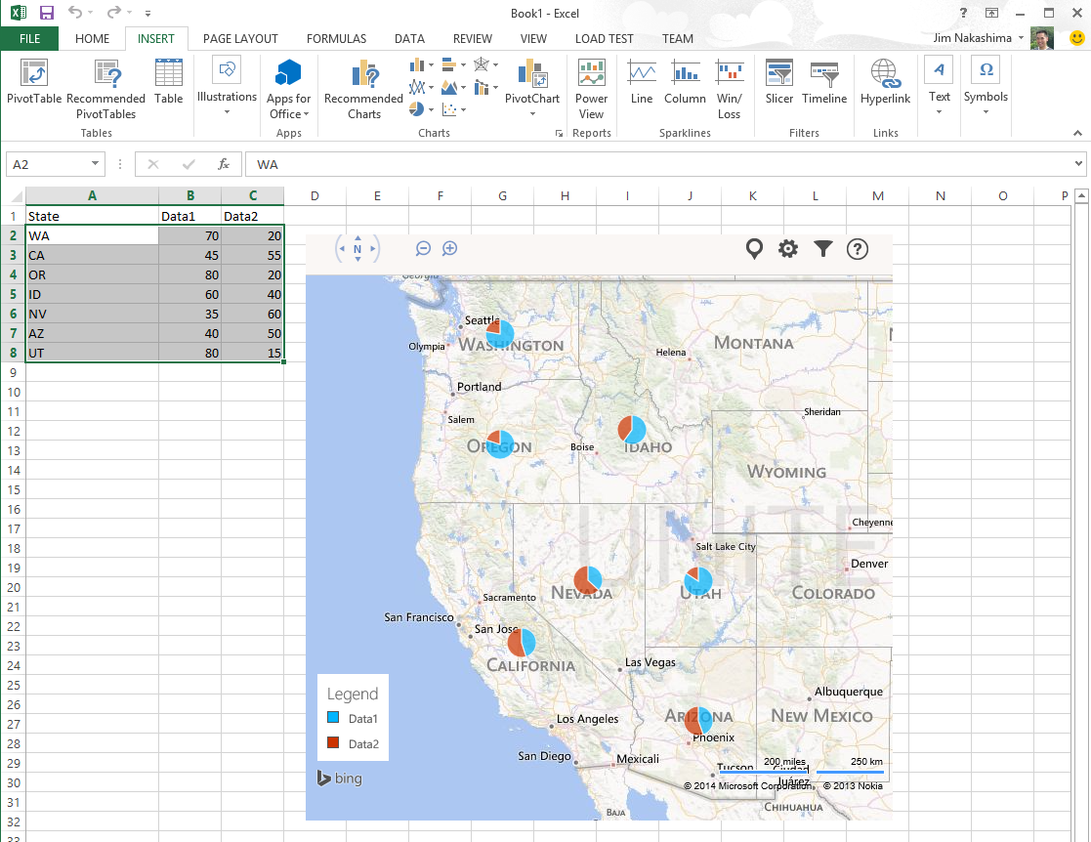
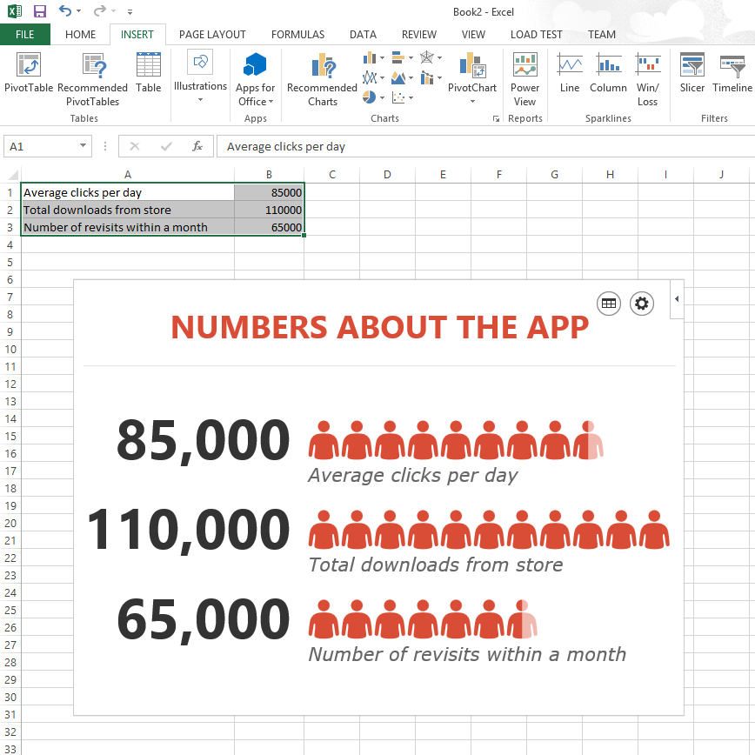
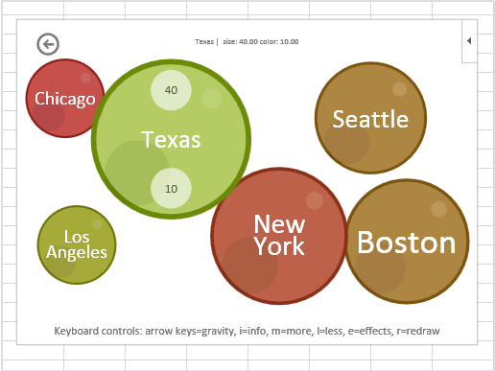
Sample Content Apps

Slide 10
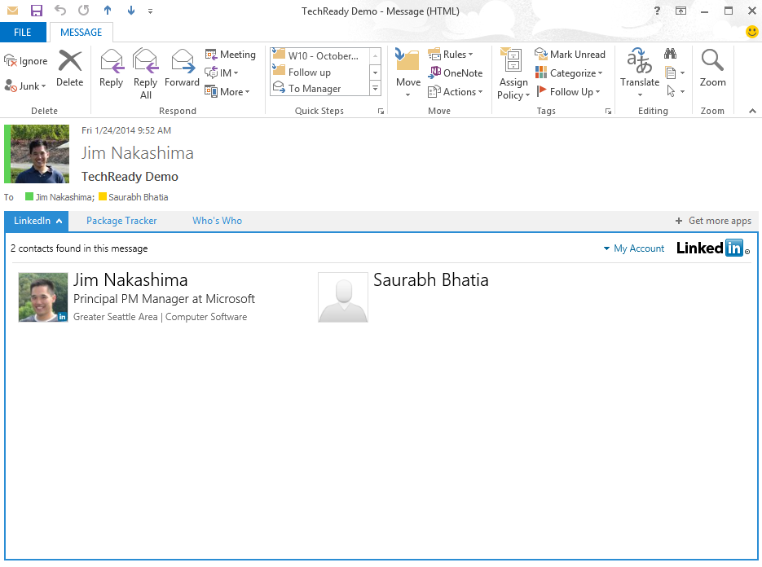
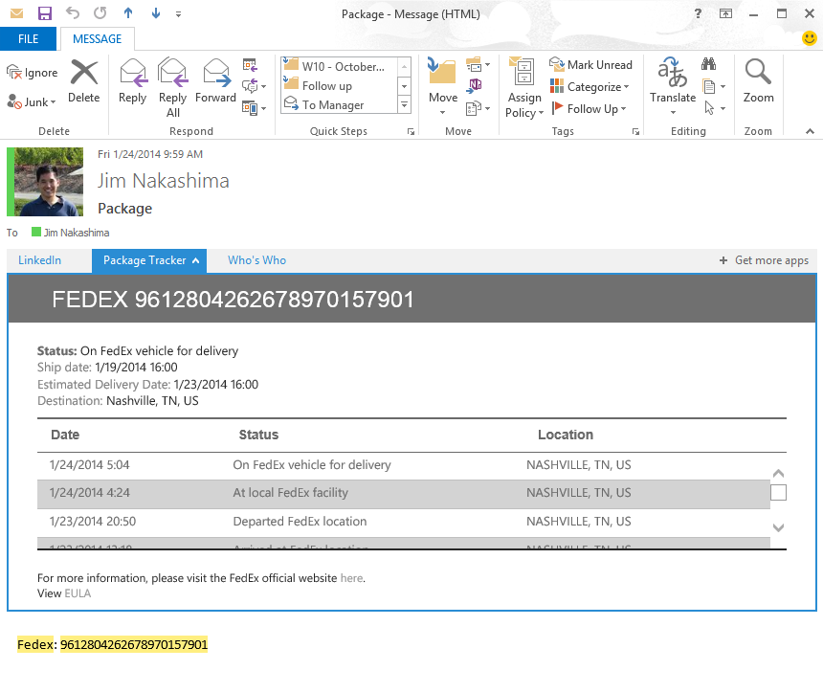
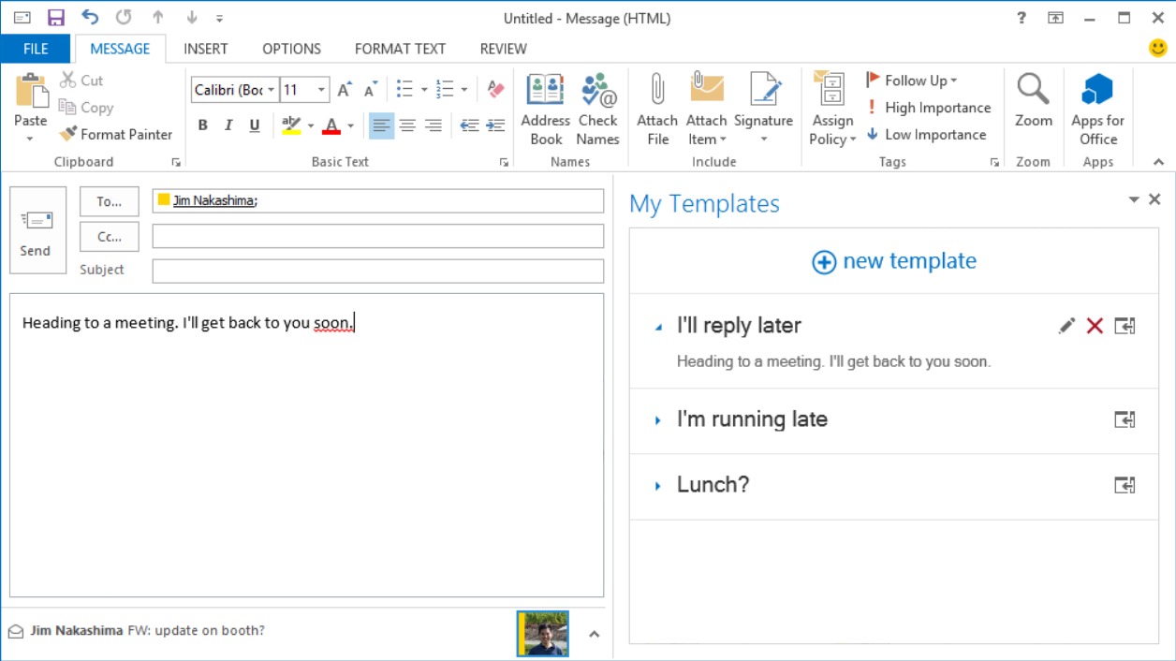
Sample Mail Apps

Slide 11
App shapes for SharePoint (Store supported)
Full page
Implement complete app experiences to satisfy
business scenarios
Parts
Create app parts that can interact with the SharePoint experience
UI command extensions
Add new commands to the ribbon and item menus

Slide 12
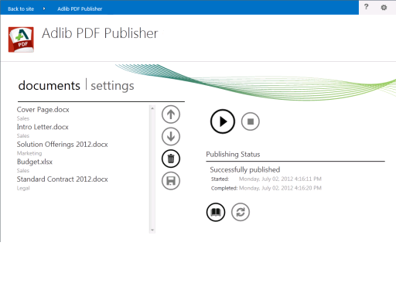
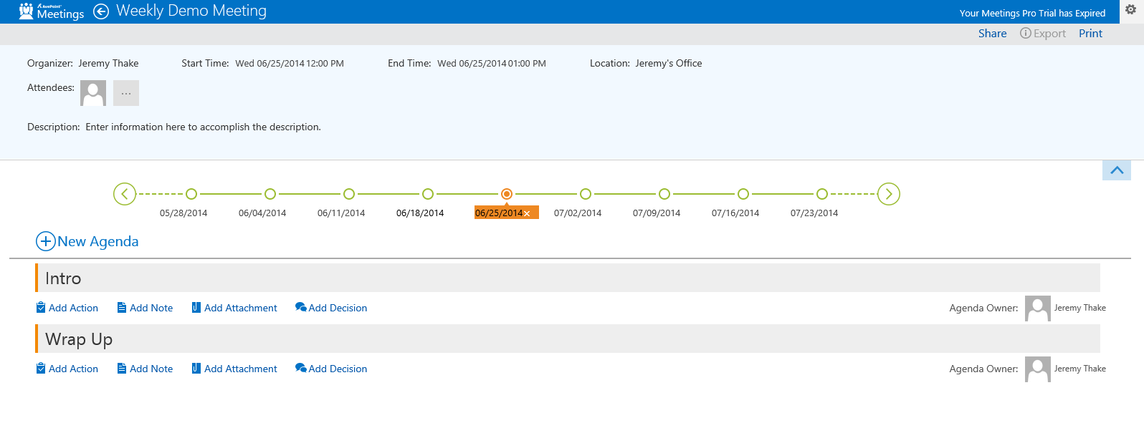
Sample SharePoint
Full-page Apps

Slide 13
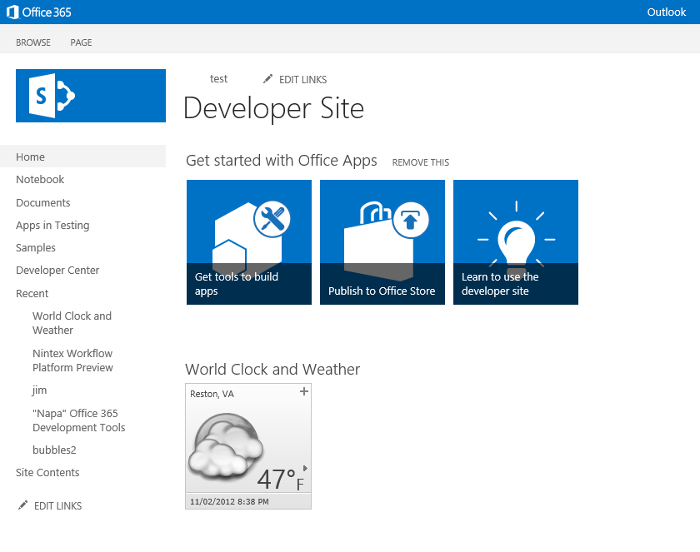
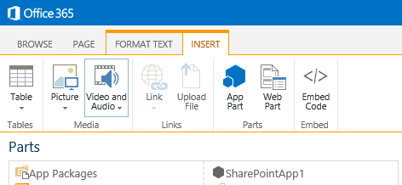
Sample SharePoint
App-Part Apps

Slide 14
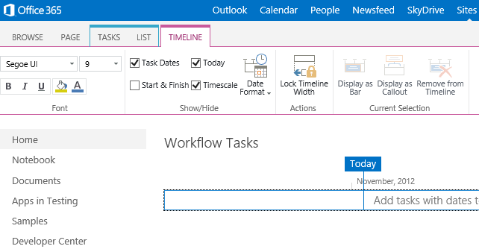
Sample SharePoint UI Command Apps

Slide 15
Architecture of Store Apps

Slide 16
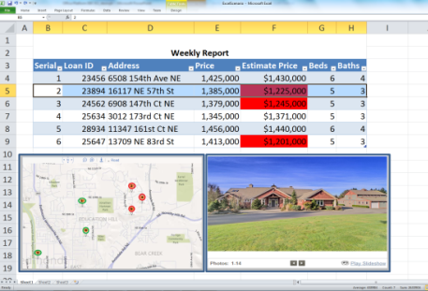

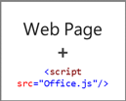
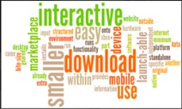
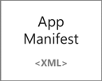
Anatomy of an app for Office in the Store
Web server
Office Store

Slide 17
SharePoint building blocks
Lists/libraries
Web parts
Site columns
Content types
Remote event receivers
Workflows

Slide 18
Architecture of SharePoint apps
SharePoint
Azure
Web application
App 2
Web
App 2
SQL
App 2
Worker
Site collection
Root site
Apache
App 1
SP hosted
App 2
Provider hosted
App 3 Provider hosted
App 3
Web
App 3
mySQL
App 3
Worker
Sub site
IIS web server
App 3
Provider hosted
App 4
Provider hosted
App 4
Web
App 4
SQL
App 4 Windows service

Slide 19
The SharePoint client APIs
Sites, Lists and Libs
Workflow
Search
Taxonomy
BCS
…
_api
Execute query
REST/ OData
JavaScript library
Silverlight library
.Net CLR library
Custom client code

Slide 20
Packaging and publishing SharePoint apps
Packaging
.app file extension—a package typically includes the following files:
AppManifest.xml
AppIcon.png
Solution file
Data tier application package
Publishing
Office Store…or (for those not wanting to sell via the Store):
App catalogs
Notes:
20488A
08: Introducing Apps for SharePoint

Slide 21
Hierarchy of Sample Scenarios Across App Types
Rich web content
YouTube video and photo gallery
Content authoring
Resumes and contracts
Business processes
Sales and marketing, finance, and HR
Data visualization, analysis and mashups
Maps, custom charts, and lookups
Dashboards
Data analysis and data mashups
Team collaboration
Content and project management
Reference tools
Translation, definitions, dictionary, help, research
Forms and
reports
Legal forms and financial reports
Workflow
Document approval and expenses
Content authoring and publishing
Doc builders and print services
App for SharePoint
Contextual content and services
Business data lookup (CRM), contextual forms (surveys)
Document template
Document template
Workflow and collaboration
Project tracking, coauthoring
App for Office
App for Office
App for Office
App for Office
App for Office
App for Office
App for Office
App for Office
App for Office

Slide 22
demo
Demos of Some leading apps

Slide 23
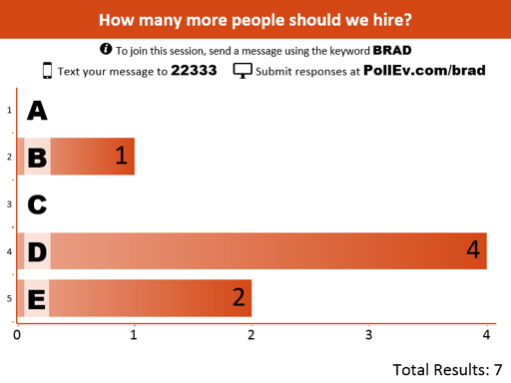
Poll Everywhere: PPT Demo
Super-easy real-time polling app, built on Ruby on Rails
Free Offer:
Up to 40 responses per poll, 1 user on account, FAQ support
Set # times each person can respond
Schedule auto-start & stop times (5 mins-1 day from now, or Custom)
Responses by text message (US), Web devices (on PollEv.com); Tweets (“@poll” + keyword), or shared Private Link on a web page
Premium features (4 levels; $15-$1,400/mo)
Max response sizes up to 20,000 and 10 admins, with greater support
Customized & branded responses
Filtered access to polls; poll reporting tools
Invite participants via link or CSV import
Moderate allowed responses on screen

Slide 24
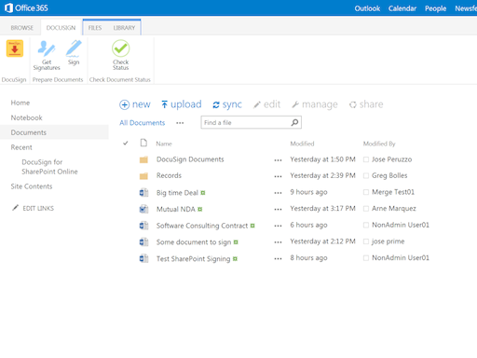
DocuSign: SharePoint Demo
Leading electronic-signature software company
Has also built apps for Word and Outlook
Has integration with One Drive for Business for doc storage
Microsoft uses DocuSign internally for many employee docs
DocuSign's doc tagging occurs right within the Word experience

Slide 25
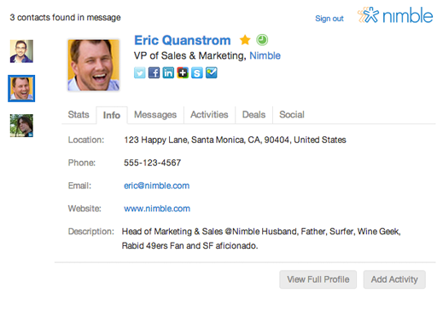
Nimble: Outlook app demo
Great tool to integrate contacts across LinkedIn, Facebook, Twitter and Google.

Slide 26
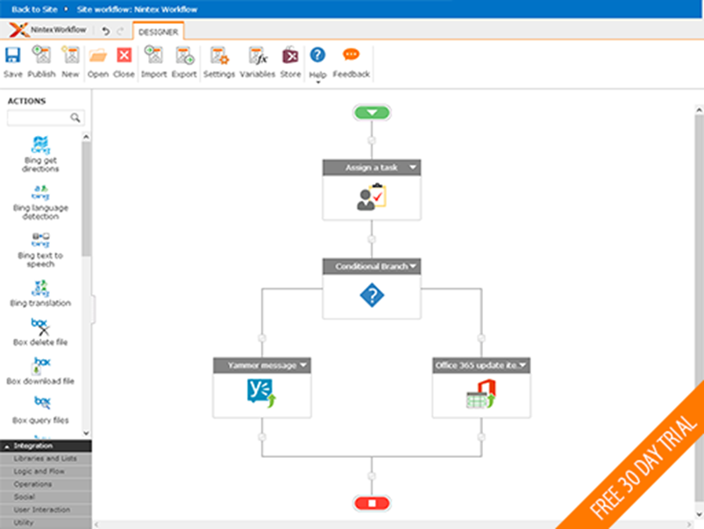
Nintex Forms & Workflow: 2 SharePoint app demos
Popular ISV: 5,000+ customers in 90 countries
High Product ROI (Forrester Total Impact Study Oct ‘14)
60% faster Workflow creation vs Visual Studio or SP
10-15% productivity gains from non-IT FTEs doing workflow
10.5 mo. payback on cost
Must install to specific SP site w/Site Admin privileges
Workflow is Provider hosted in Azure

Slide 27
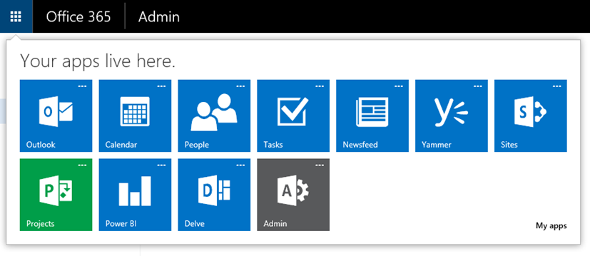
Store App Types of the future
“Suite-level” extensions registered with Azure AD
Store provisioning to start in H1 2015, starting with Free
Seller Dashboard submission much the same
365-specific app Store to surface within Office 365 App Launcher
365 extensions will be “first class citizens” within Office 365, greatly increasing their visibility and use
Future Stores may surface Azure Single Sign On web solutions

Slide 28
Summary
App Types Supported in the Store
Architecture of Store Apps
Demo-fest:
Poll Everywhere
DocuSign
Nimble
Nintex

Slide 29
Developer Program Launch
1 YEAR FREE
E-mail Newsletters
Free Developer Subscription
Free Training
Free Tools
Webinars
http://dev.office.com/devprogram

Slide 30


Engage
Office 365 Network
https://www.yammer.com/itpronetwork
Twitter
S
S
t
t
a
a
r
r
t
t
@OfficeDev
Stack overflow
[ms-office]
Channel 9 Dev Show
http://aka.ms/O365DevShow
Podcasts http://dev.office.com/podcasts
Snack Demos
http://aka.ms/o365DevSnackDemos
UserVoice
http://officespdev.uservoice.com/

